Slide 1


大模型系列 – AI 集群
NV Blackwell
产品演进分析
ZOMI

Slide 2
NVIDIA GPU架构发展
架构名称 | Fermi | Kepler | Maxwell | Pascal | Volta | Turing | Ampere | Hopper
中文名字 | 费米 | 开普勒 | 麦克斯韦 | 帕斯卡 | 伏特 | 图灵 | 安培 | 赫柏
发布时间 | 2010 | 2012 | 2014 | 2016 | 2017 | 2018 | 2020 | 2022
核心参数 | 16个SM，每个SM包含32个CUDA Cores，一共512 CUDA Cores | 15个SMX，每个SMX包括192个FP32+64个FP64 CUDA Cores | 16个SM，每个SM包括4个处理块，每个处理块包括32个CUDA Cores+8个LD/ST Unit + 8 SFU | GP100有60个SM，每个SM包括64个CUDA Cores，32个DP Cores | 80个SM，每个SM包括32个FP64+64 Int32+64 FP32+8个Tensor Cores | 102核心92个SM，SM重新设计，每个SM包含64个Int32+64个FP32+8个Tensor Cores | 108个SM，每个SM包含64个FP32+64个INT32+32个FP64+4个Tensor Cores | 132个SM，每个SM包含128个FP32+64个INT32+64个FP64+4个Tensor Cores
特点&优势 | 首个完整GPU计算架构，支持与共享存储结合的Cache层次GPU架构，支持ECC GPU架构 | 游戏性能大幅提升，首次支持GPU Direct技术 | 每组SM单元从192个减少到每组128个，每个SMM单元拥有更多逻辑控制电路 | NVLink第一代，双向互联带宽160GB/s，P100拥有56个SM HBM | NVLink2.0，Tensor Cores第一代，支持AI运算 | Tensor Core2.0，RT Core第一代 | Tensor Core3.0，RT Core2.0，NVLink3.0，结构稀疏性矩阵MIG1.0 | Tensor Core4.0，NVlink4.0，结构稀疏性矩阵MIG2.0
纳米制程 | 40/28nm 30亿晶体管 | 28nm 71亿晶体管 | 28nm 80亿晶体管 | 16nm 153亿晶体管 | 12nm 211亿晶体管 | 12nm 186亿晶体管 | 7nm 283亿晶体管 | 4nm 800亿晶体管
代表型号 | Quadro 7000 | K80 K40M | M5000 M4000 GTX 9XX系列 | P100 P6000 TTX1080 | V100 TiTan V | T4，2080TI RTX 5000 | A100 A30系列 | H100

Slide 3
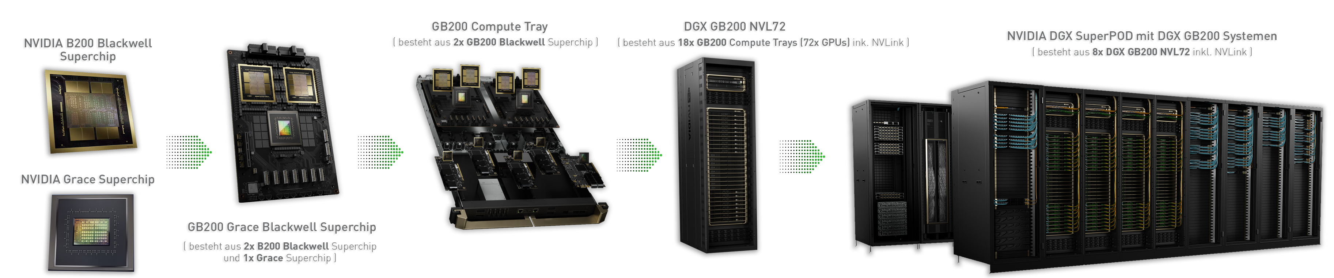
NVIDIA GPU架构发展
B200、B100、GB200、NVL72、NVL32、SuperPod、GH200、H200、H100、L20、SuperPod-576
ConnectX-800G网卡、网络交换机

Slide 4
本节内容
单 GPU 介绍
HGX 产品
NVL 产品

Slide 5
01
GPU产品介绍

Slide 6
单 GPU 产品介绍
产品 | A100 | H100 | H200 | GH200 | B100 | B200 | Full B200 | GB200
架构 | Ampere | Hopper |  |  | Blackwell
HBM 大小 | 80GB | 80GB | 141GB | 96GB/141GB | 180GB/192GB | 180GB/192GB | 192GB | 384GB
HBM 带宽 | 2TB/s | 3.35TB/s | 4.8TB/s | 4TB/s 4.9TB/s | 8TB/s | 8TB/s | 8TB/s | 16TB/s
FP16 (FLOPS) | 312T | 1P | 1P | 1P | 1.75P | 2.25P | 2.5P | 5P
INT8 (OPS) | 624T | 2P | 2P | 2P | 3.5P | 4.5P | 5P | 10P
FP8 (FLOPS) | N | 2P | 2P | 2P | 3.5P | 4.5P | 5P | 10P
FP6 (FLOPS) | N | N | N | N | 3.5P | 4.5P | 5P | 10P
FP4 (FLOPS) | N | N | N | N | 7P | 9P | 10P | 20P
NVLink 带宽 | 600GB/s | 900GB/s | 900GB/s | 900GB/s | 1.8TB/s | 1.8TB/s | 1.8TB/s | 3.6TB/s
Powers | 400w | 700w | 700w | 1000w | 700w | 1000w | 1200w | 2700w
Others | 1 Die | 1 Die | 1 Die | 1 Grace CPU + 1 H200 GPU | 2 Die | 2 Die | 2 Die | 1 Grace CPU + B200 GPU

Slide 7
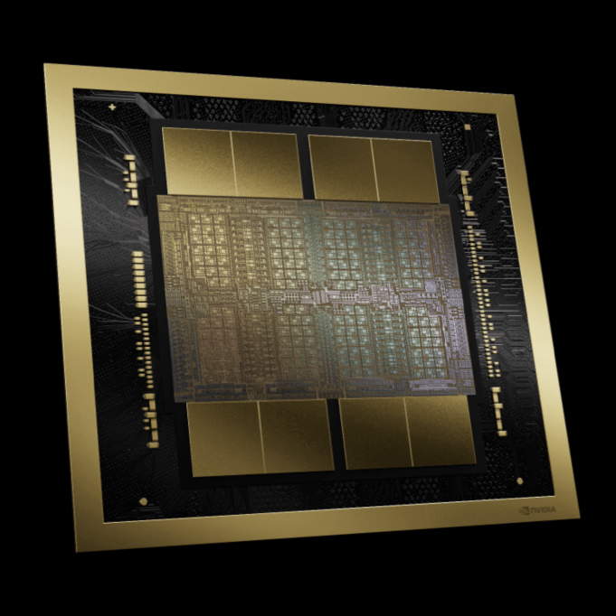
单 GPU 产品介绍
产品 | B100 | B200 | Full B200 | GB200
架构 | Blackwell
HBM 大小 | 180GB/192GB | 180GB/192GB | 192GB | 384GB
HBM 带宽 | 8TB/s | 8TB/s | 8TB/s | 16TB/s
FP16 (FLOPS) | 1.75P | 2.25P | 2.5P | 5P
INT8 (OPS) | 3.5P | 4.5P | 5P | 10P
FP8 (FLOPS) | 3.5P | 4.5P | 5P | 10P
FP6 (FLOPS) | 3.5P | 4.5P | 5P | 10P
FP4 (FLOPS) | 7P | 9P | 10P | 20P
NVLink 带宽 | 1.8TB/s | 1.8TB/s | 1.8TB/s | 3.6TB/s
Powers | 700w | 1000w | 1200w | 2700w
Others | 2 Die | 2 Die | 2 Die | 1 Grace CPU + B200 GPU

Slide 8
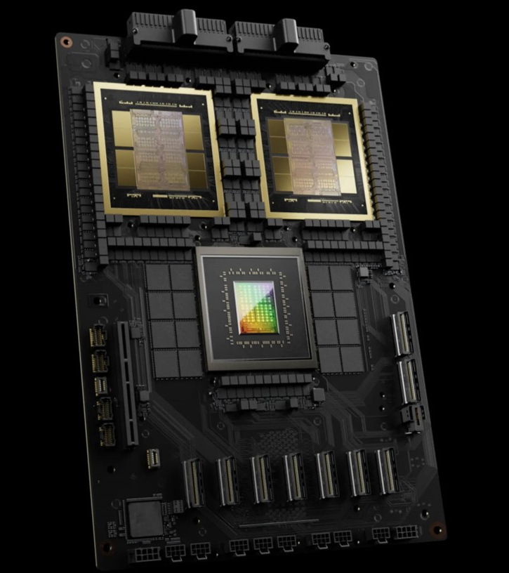
单 GPU 产品介绍
产品 | B100 | B200 | Full B200 | GB200
架构 | Blackwell
HBM 大小 | 180GB/192GB | 180GB/192GB | 192GB | 384GB
HBM 带宽 | 8TB/s | 8TB/s | 8TB/s | 16TB/s
FP16 (FLOPS) | 1.75P | 2.25P | 2.5P | 5P
INT8 (OPS) | 3.5P | 4.5P | 5P | 10P
FP8 (FLOPS) | 3.5P | 4.5P | 5P | 10P
FP6 (FLOPS) | 3.5P | 4.5P | 5P | 10P
FP4 (FLOPS) | 7P | 9P | 10P | 20P
NVLink 带宽 | 1.8TB/s | 1.8TB/s | 1.8TB/s | 3.6TB/s
Powers | 700w | 1000w | 1200w | 2700w
Others | 2 Die | 2 Die | 2 Die | 1 Grace CPU + B200 GPU

Slide 9
单 GPU 产品介绍
A100 -> H100 FP16 算力增加 3 倍多，功耗只从 400w 增加到 700w
产品 | A100 | H100 | H200 | GH200 | B100 | B200 | Full B200 | GB200
架构 | Ampere | Hopper |  |  | Blackwell
HBM 大小 | 80GB | 80GB | 141GB | 96GB/141GB | 180GB/192GB | 180GB/192GB | 192GB | 384GB
HBM 带宽 | 2TB/s | 3.35TB/s | 4.8TB/s | 4TB/s 4.9TB/s | 8TB/s | 8TB/s | 8TB/s | 16TB/s
FP16 (FLOPS) | 312T | 1P | 1P | 1P | 1.75P | 2.25P | 2.5P | 5P
INT8 (OPS) | 624T | 2P | 2P | 2P | 3.5P | 4.5P | 5P | 10P
FP8 (FLOPS) | N | 2P | 2P | 2P | 3.5P | 4.5P | 5P | 10P
FP6 (FLOPS) | N | N | N | N | 3.5P | 4.5P | 5P | 10P
FP4 (FLOPS) | N | N | N | N | 7P | 9P | 10P | 20P
NVLink 带宽 | 600GB/s | 900GB/s | 900GB/s | 900GB/s | 1.8TB/s | 1.8TB/s | 1.8TB/s | 3.6TB/s
Powers | 400w | 700w | 700w | 1000w | 700w | 1000w | 1200w | 2700w
Others | 1 Die | 1 Die | 1 Die | 1 Grace CPU + 1 H200 GPU | 2 Die | 2 Die | 2 Die | 1 Grace CPU + B200 GPU

Slide 10
单 GPU 产品介绍
H200 -> B200 FP16 算力增加 2 倍多，功耗只从 700w 增加到 1000w
产品 | A100 | H100 | H200 | GH200 | B100 | B200 | Full B200 | GB200
架构 | Ampere | Hopper |  |  | Blackwell
HBM 大小 | 80GB | 80GB | 141GB | 96GB/141GB | 180GB/192GB | 180GB/192GB | 192GB | 384GB
HBM 带宽 | 2TB/s | 3.35TB/s | 4.8TB/s | 4TB/s 4.9TB/s | 8TB/s | 8TB/s | 8TB/s | 16TB/s
FP16 (FLOPS) | 312T | 1P | 1P | 1P | 1.75P | 2.25P | 2.5P | 5P
INT8 (OPS) | 624T | 2P | 2P | 2P | 3.5P | 4.5P | 5P | 10P
FP8 (FLOPS) | N | 2P | 2P | 2P | 3.5P | 4.5P | 5P | 10P
FP6 (FLOPS) | N | N | N | N | 3.5P | 4.5P | 5P | 10P
FP4 (FLOPS) | N | N | N | N | 7P | 9P | 10P | 20P
NVLink 带宽 | 600GB/s | 900GB/s | 900GB/s | 900GB/s | 1.8TB/s | 1.8TB/s | 1.8TB/s | 3.6TB/s
Powers | 400w | 700w | 700w | 1000w | 700w | 1000w | 1200w | 2700w
Others | 1 Die | 1 Die | 1 Die | 1 Grace CPU + 1 H200 GPU | 2 Die | 2 Die | 2 Die | 1 Grace CPU + B200 GPU

Slide 11
单 GPU 产品介绍
B200 FP16 算力是 A100 的 7 倍，而功耗是其 2.5 倍
产品 | A100 | H100 | H200 | GH200 | B100 | B200 | Full B200 | GB200
架构 | Ampere | Hopper |  |  | Blackwell
HBM 大小 | 80GB | 80GB | 141GB | 96GB/141GB | 180GB/192GB | 180GB/192GB | 192GB | 384GB
HBM 带宽 | 2TB/s | 3.35TB/s | 4.8TB/s | 4TB/s 4.9TB/s | 8TB/s | 8TB/s | 8TB/s | 16TB/s
FP16 (FLOPS) | 312T | 1P | 1P | 1P | 1.75P | 2.25P | 2.5P | 5P
INT8 (OPS) | 624T | 2P | 2P | 2P | 3.5P | 4.5P | 5P | 10P
FP8 (FLOPS) | N | 2P | 2P | 2P | 3.5P | 4.5P | 5P | 10P
FP6 (FLOPS) | N | N | N | N | 3.5P | 4.5P | 5P | 10P
FP4 (FLOPS) | N | N | N | N | 7P | 9P | 10P | 20P
NVLink 带宽 | 600GB/s | 900GB/s | 900GB/s | 900GB/s | 1.8TB/s | 1.8TB/s | 1.8TB/s | 3.6TB/s
Powers | 400w | 700w | 700w | 1000w | 700w | 1000w | 1200w | 2700w
Others | 1 Die | 1 Die | 1 Die | 1 Grace CPU + 1 H200 GPU | 2 Die | 2 Die | 2 Die | 1 Grace CPU + B200 GPU

Slide 12
单 GPU 产品介绍
Blackwell GPU 支持 FP4 精度，其算力为 FP8 的两倍
产品 | A100 | H100 | H200 | GH200 | B100 | B200 | Full B200 | GB200
架构 | Ampere | Hopper |  |  | Blackwell
HBM 大小 | 80GB | 80GB | 141GB | 96GB/141GB | 180GB/192GB | 180GB/192GB | 192GB | 384GB
HBM 带宽 | 2TB/s | 3.35TB/s | 4.8TB/s | 4TB/s 4.9TB/s | 8TB/s | 8TB/s | 8TB/s | 16TB/s
FP16 (FLOPS) | 312T | 1P | 1P | 1P | 1.75P | 2.25P | 2.5P | 5P
INT8 (OPS) | 624T | 2P | 2P | 2P | 3.5P | 4.5P | 5P | 10P
FP8 (FLOPS) | N | 2P | 2P | 2P | 3.5P | 4.5P | 5P | 10P
FP6 (FLOPS) | N | N | N | N | 3.5P | 4.5P | 5P | 10P
FP4 (FLOPS) | N | N | N | N | 7P | 9P | 10P | 20P
NVLink 带宽 | 600GB/s | 900GB/s | 900GB/s | 900GB/s | 1.8TB/s | 1.8TB/s | 1.8TB/s | 3.6TB/s
Powers | 400w | 700w | 700w | 1000w | 700w | 1000w | 1200w | 2700w
Others | 1 Die | 1 Die | 1 Die | 1 Grace CPU + 1 H200 GPU | 2 Die | 2 Die | 2 Die | 1 Grace CPU + B200 GPU

Slide 13
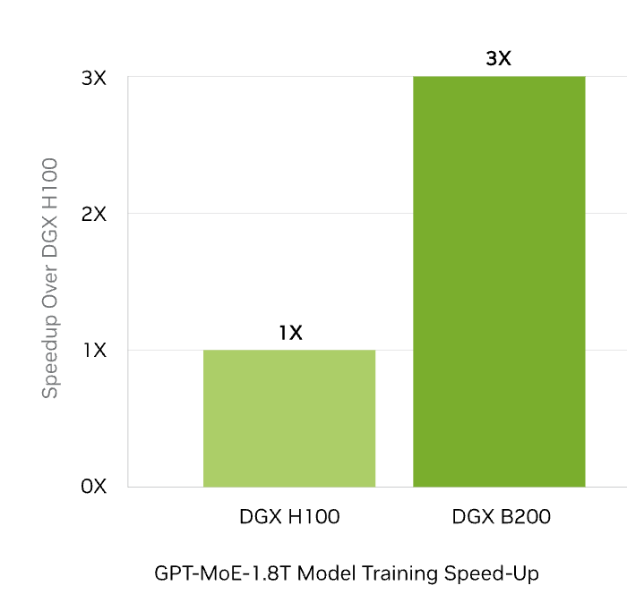
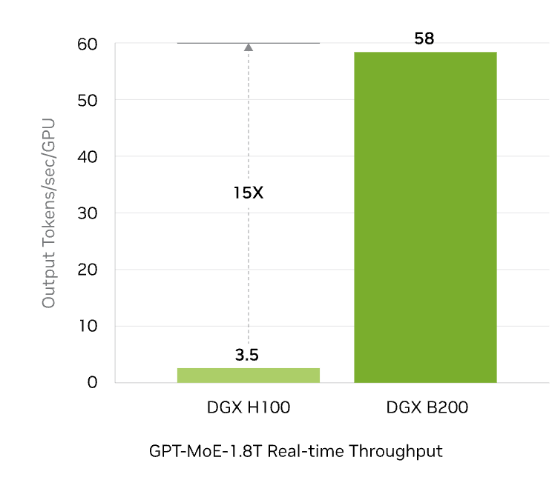
DGX B200 适用于推理！
Real Time Large Language Model Inference
Supercharged AI Training Performance
HGX H100 -> HGX B200 FP16/FP8 算力提升 2.25 倍，HBM 更大，显存带宽也达到 2.3 倍左右，NVLink 带宽加倍，假设 MFU 为 50%，那整体训练速度提升 3 倍符合预期。

Slide 14
DGX B200 不一定适用于推理！
Real Time Large Language Model Inference
Supercharged AI Training Performance
用 FP4 算力和 Hopper 架构的 FP8 算力比较

Slide 15
02
HGX 服务器

Slide 16
HGX 服务器介绍
产品 | HGX A100 | HGX H100 | HGX H200 | HGX B100 | HGX B200
 | 8xA100 SXM | 8xH100 SXM | 8xH200 SXM | 8xB100 SXM | 8xB200 SXM
架构 | Ampere | Hopper |  | Blackwell
HBM 大小 | 640GB | 1.1TB |  | 1.44TB/1.5TB
HBM 带宽 | 2TB/s | 3.35TB/s | 4.8TB/s | 8TB/s | 8TB/s
FP16 (FLOPS) | 312T | 1P | 1P | 1.75P | 2.25P
INT8 (OPS) | 624T | 2P | 2P | 3.5P | 4.5P
FP8 (FLOPS) | N | 2P | 2P | 3.5P | 4.5P
FP6 (FLOPS) | N | N | N | 3.5P | 4.5P
FP4 (FLOPS) | N | N | N | 7P | 9P
GPU-GPU 带宽 | 600 GB/s | 900 GB/s |  | 1.8 TB/s
NVLink 带宽 | 4.8 TB/s | 7.2 TB/s |  | 14.4 T/s
Ethernet 带宽 | 200 Gb/s | 400 Gb/s + 20 0Gb/s |  | 2 x 400 Gb/s
IB 带宽 | 8 x 200 Gb/s | 8 x 400Gb/s |  | 8 x 400 Gb/s
GPUs Power | 3.2kw | 5.6kw |  | 5.6kw | 8kw
总Power | 6.5kw | 10.2kw |  | 10.2kw | 14.3kw
网络产品 | ConnectX-6 NIC | ConnectX-7 NIC |  | BlueField-3 DPU + ConnectX-7 NIC

Slide 17
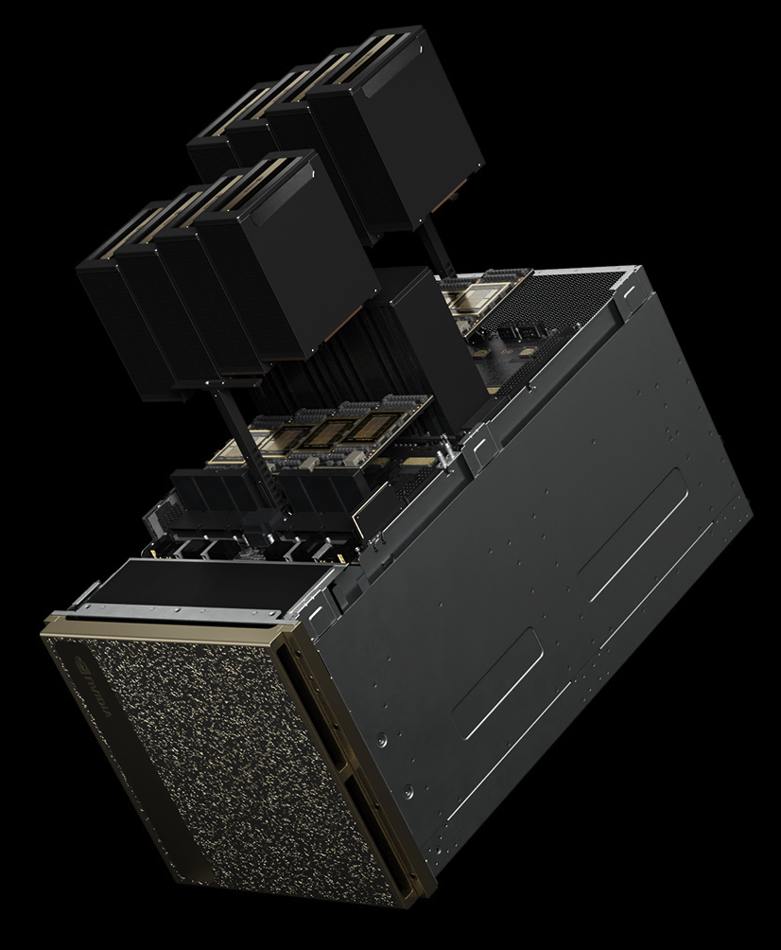
HGX 服务器介绍
产品 | HGX B100 | HGX B200
 | 8xB100 SXM | 8xB200 SXM
架构 | Blackwell
HBM 大小 | 1.44TB/1.5TB
HBM 带宽 | 8TB/s | 8TB/s
FP16 (FLOPS) | 1.75P | 2.25P
INT8 (OPS) | 3.5P | 4.5P
FP8 (FLOPS) | 3.5P | 4.5P
FP6 (FLOPS) | 3.5P | 4.5P
FP4 (FLOPS) | 7P | 9P
GPU-GPU 带宽 | 1.8 TB/s
NVLink 带宽 | 14.4 T/s
Ethernet 带宽 | 2 x 400 Gb/s
IB 带宽 | 8 x 400 Gb/s
GPUs Power | 5.6kw | 8kw
总Power | 10.2kw | 14.3kw
网络产品 | BlueField-3 DPU + ConnectX-7 NIC

Slide 18
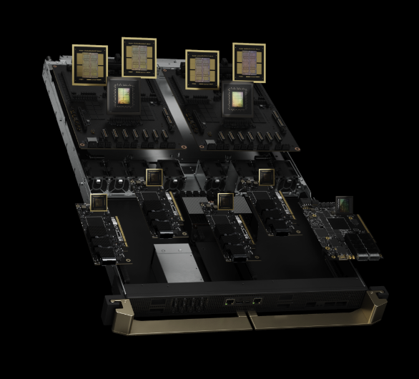
HGX 服务器介绍
产品 | HGX B100 | HGX B200
 | 8xB100 SXM | 8xB200 SXM
架构 | Blackwell
HBM 大小 | 1.44TB/1.5TB
HBM 带宽 | 8TB/s | 8TB/s
FP16 (FLOPS) | 1.75P | 2.25P
INT8 (OPS) | 3.5P | 4.5P
FP8 (FLOPS) | 3.5P | 4.5P
FP6 (FLOPS) | 3.5P | 4.5P
FP4 (FLOPS) | 7P | 9P
GPU-GPU 带宽 | 1.8 TB/s
NVLink 带宽 | 14.4 T/s
Ethernet 带宽 | 2 x 400 Gb/s
IB 带宽 | 8 x 400 Gb/s
GPUs Power | 5.6kw | 8kw
总Power | 10.2kw | 14.3kw
网络产品 | BlueField-3 DPU + ConnectX-7 NIC

Slide 19
HGX 服务器介绍
HGX A100 -> HGX H100 or HGX H200，FP16 算力增加到 3.3 倍，功耗不到原来 2 倍
产品 | HGX A100 | HGX H100 | HGX H200 | HGX B100 | HGX B200
 | 8xA100 SXM | 8xH100 SXM | 8xH200 SXM | 8xB100 SXM | 8xB200 SXM
架构 | Ampere | Hopper |  | Blackwell
HBM 大小 | 640GB | 1.1TB |  | 1.44TB/1.5TB
HBM 带宽 | 2TB/s | 3.35TB/s | 4.8TB/s | 8TB/s | 8TB/s
FP16 (FLOPS) | 312T | 1P | 1P | 1.75P | 2.25P
INT8 (OPS) | 624T | 2P | 2P | 3.5P | 4.5P
FP8 (FLOPS) | N | 2P | 2P | 3.5P | 4.5P
FP6 (FLOPS) | N | N | N | 3.5P | 4.5P
FP4 (FLOPS) | N | N | N | 7P | 9P
GPU-GPU 带宽 | 600 GB/s | 900 GB/s |  | 1.8 TB/s
NVLink 带宽 | 4.8 TB/s | 7.2 TB/s |  | 14.4 T/s
Ethernet 带宽 | 200 Gb/s | 400 Gb/s + 20 0Gb/s |  | 2 x 400 Gb/s
IB 带宽 | 8 x 200 Gb/s | 8 x 400Gb/s |  | 8 x 400 Gb/s
GPUs Power | 3.2kw | 5.6kw |  | 5.6kw | 8kw
总Power | 6.5kw | 10.2kw |  | 10.2kw | 14.3kw
网络产品 | ConnectX-6 NIC | ConnectX-7 NIC |  | BlueField-3 DPU + ConnectX-7 NIC

Slide 20
HGX 服务器介绍
HGX H100 & HGX H200 -> HGX B100 & HGX B200，FP16 算力增加到 2 倍左右，功耗相当
产品 | HGX A100 | HGX H100 | HGX H200 | HGX B100 | HGX B200
 | 8xA100 SXM | 8xH100 SXM | 8xH200 SXM | 8xB100 SXM | 8xB200 SXM
架构 | Ampere | Hopper |  | Blackwell
HBM 大小 | 640GB | 1.1TB |  | 1.44TB/1.5TB
HBM 带宽 | 2TB/s | 3.35TB/s | 4.8TB/s | 8TB/s | 8TB/s
FP16 (FLOPS) | 312T | 1P | 1P | 1.75P | 2.25P
INT8 (OPS) | 624T | 2P | 2P | 3.5P | 4.5P
FP8 (FLOPS) | N | 2P | 2P | 3.5P | 4.5P
FP6 (FLOPS) | N | N | N | 3.5P | 4.5P
FP4 (FLOPS) | N | N | N | 7P | 9P
GPU-GPU 带宽 | 600 GB/s | 900 GB/s |  | 1.8 TB/s
NVLink 带宽 | 4.8 TB/s | 7.2 TB/s |  | 14.4 T/s
Ethernet 带宽 | 200 Gb/s | 400 Gb/s + 20 0Gb/s |  | 2 x 400 Gb/s
IB 带宽 | 8 x 200 Gb/s | 8 x 400Gb/s |  | 8 x 400 Gb/s
GPUs Power | 3.2kw | 5.6kw |  | 5.6kw | 8kw
总Power | 6.5kw | 10.2kw |  | 10.2kw | 14.3kw
网络产品 | ConnectX-6 NIC | ConnectX-7 NIC |  | BlueField-3 DPU + ConnectX-7 NIC

Slide 21
HGX 服务器介绍
HGX B100 & HGX B200 网络基本没有升级，IB 仍然选择 8x400Gb/s
产品 | HGX A100 | HGX H100 | HGX H200 | HGX B100 | HGX B200
 | 8xA100 SXM | 8xH100 SXM | 8xH200 SXM | 8xB100 SXM | 8xB200 SXM
架构 | Ampere | Hopper |  | Blackwell
HBM 大小 | 640GB | 1.1TB |  | 1.44TB/1.5TB
HBM 带宽 | 2TB/s | 3.35TB/s | 4.8TB/s | 8TB/s | 8TB/s
FP16 (FLOPS) | 312T | 1P | 1P | 1.75P | 2.25P
INT8 (OPS) | 624T | 2P | 2P | 3.5P | 4.5P
FP8 (FLOPS) | N | 2P | 2P | 3.5P | 4.5P
FP6 (FLOPS) | N | N | N | 3.5P | 4.5P
FP4 (FLOPS) | N | N | N | 7P | 9P
GPU-GPU 带宽 | 600 GB/s | 900 GB/s |  | 1.8 TB/s
NVLink 带宽 | 4.8 TB/s | 7.2 TB/s |  | 14.4 T/s
Ethernet 带宽 | 200 Gb/s | 400 Gb/s + 20 0Gb/s |  | 2 x 400 Gb/s
IB 带宽 | 8 x 200 Gb/s | 8 x 400Gb/s |  | 8 x 400 Gb/s
GPUs Power | 3.2kw | 5.6kw |  | 5.6kw | 8kw
总Power | 6.5kw | 10.2kw |  | 10.2kw | 14.3kw
网络产品 | ConnectX-6 NIC | ConnectX-7 NIC |  | BlueField-3 DPU + ConnectX-7 NIC

Slide 22
03
NVL & SuperPod

Slide 23
NVL & SuperPod 介绍
产品 | NVL 32 | GH200 SuperPod | NVL72 | GB200 SuperPod
 | 32 x GH200 | 256 x GH200 | 36 x GB200 | 288 x GB200
 | 32 x GPU | 256 GPU | 72 GPU | 576 x GPU
架构 | Hopper |  | Blackwell
HBM 大小 | 32 x 144GB = 4.6T | 256 x 96GB = 24.5T | 32 x 384GB = 13.8T | 288 x 384GB = 110T
LPDDR5X 大小 | 32 x 480GB = 15.4T | 256 x 480GB = 123T | 32 x 480GB = 17.3T | 288 x 480GB = 138T
HBM 带宽 | 3.35TB/s | 4.8TB/s | 8TB/s | 8TB/s
FP16 (FLOPS) | 32P | 256P | 180P | 1440P
INT8 (OPS) | 64P | 64P | 360P | 2880P
FP8 (FLOPS) | 64P | 64P | 360P | 2880P
FP6 (FLOPS) |  |  | 360P | 2880P
FP4 (FLOPS) |  |  | 720P | 5760P
GPU-GPU 带宽 | 0.9TB/s | 0.9TB/s | 1.8TB/s | 1.8TB/s
NVSwitch | Gen3 64 Port/NVSwitch |  | Gen4 72 Port/NVSwitch
NVLink 带宽 | 36 x 0.9T/s=32TB/s | 256 x 0.9T/s=230TB/s | 72 x 1.8T/s=130TB/s | 576 x 1.8T/s=1PB/s
Ethernet 带宽 | 16 x 200Gb/s | 256 x 200Gb/s | 18 x 400Gb/s | 576 x 400Gb/s
IB 带宽 | 32 x 400Gb/s | 256 x 400Gb/s | 72 x 800Gb/s | 576 x 800Gb/s
GPUs Power | 32 x 1kw=32kw | 256 x 1kw=256kw | 36 x 2.7kw=97.2kw | 288 x 2.7kw=777.6kw
网络产品 | ConnectX-7 NIC |  | ConnectX-8 NIC

Slide 24
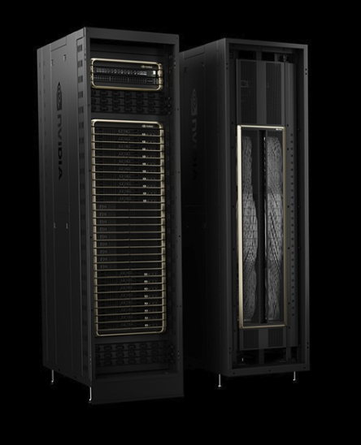
NVL & SuperPod 介绍
产品 | NVL72 | GB200 SuperPod
 | 36 x GB200 | 288 x GB200
 | 72 GPU | 576 x GPU
架构 | Blackwell
HBM 大小 | 32 x 384GB = 13.8T | 288 x 384GB = 110T
LPDDR5X 大小 | 32 x 480GB = 17.3T | 288 x 480GB = 138T
HBM 带宽 | 8TB/s | 8TB/s
FP16 (FLOPS) | 180P | 1440P
INT8 (OPS) | 360P | 2880P
FP8 (FLOPS) | 360P | 2880P
FP6 (FLOPS) | 360P | 2880P
FP4 (FLOPS) | 720P | 5760P
GPU-GPU 带宽 | 1.8TB/s | 1.8TB/s
NVSwitch | Gen4 72 Port/NVSwitch
NVLink 带宽 | 72 x 1.8T/s=130TB/s | 576 x 1.8T/s=1PB/s
Ethernet 带宽 | 18 x 400Gb/s | 576 x 400Gb/s
IB 带宽 | 72 x 800Gb/s | 576 x 800Gb/s
GPUs Power | 36 x 2.7kw=97.2kw | 288 x 2.7kw=777.6kw
网络产品 | ConnectX-8 NIC

Slide 25
NVL & SuperPod 介绍
NVL32 -> NVL72，GPU 数从 32 增加到 72，FP16 从 32P 到 180P (近 6 倍)
产品 | NVL 32 | GH200 SuperPod | NVL72 | GB200 SuperPod
 | 32 x GH200 | 256 x GH200 | 36 x GB200 | 288 x GB200
 | 32 x GPU | 256 GPU | 72 GPU | 576 x GPU
架构 | Hopper |  | Blackwell
HBM 大小 | 32 x 144GB = 4.6T | 256 x 96GB = 24.5T | 32 x 384GB = 13.8T | 288 x 384GB = 110T
LPDDR5X 大小 | 32 x 480GB = 15.4T | 256 x 480GB = 123T | 32 x 480GB = 17.3T | 288 x 480GB = 138T
HBM 带宽 | 3.35TB/s | 4.8TB/s | 8TB/s | 8TB/s
FP16 (FLOPS) | 32P | 256P | 180P | 1440P
INT8 (OPS) | 64P | 64P | 360P | 2880P
FP8 (FLOPS) | 64P | 64P | 360P | 2880P
GPU-GPU 带宽 | 0.9TB/s | 0.9TB/s | 1.8TB/s | 1.8TB/s
NVSwitch | Gen3 64 Port/NVSwitch |  | Gen4 72 Port/NVSwitch
NVLink 带宽 | 36 x 0.9T/s=32TB/s | 256 x 0.9T/s=230TB/s | 72 x 1.8T/s=130TB/s | 576 x 1.8T/s=1PB/s
Ethernet 带宽 | 16 x 200Gb/s | 256 x 200Gb/s | 18 x 400Gb/s | 576 x 400Gb/s
IB 带宽 | 32 x 400Gb/s | 256 x 400Gb/s | 72 x 800Gb/s | 576 x 800Gb/s
GPUs Power | 32 x 1kw=32kw | 256 x 1kw=256kw | 36 x 2.7kw=97.2kw | 288 x 2.7kw=777.6kw
网络产品 | ConnectX-7 NIC |  | ConnectX-8 NIC

Slide 26
NVL & SuperPod 介绍
GH200 SuperPod -> GB200 SuperPod，GPU 数从 256 到 576，FP16 从 256P 到 1440P (近 6 倍)
产品 | NVL 32 | GH200 SuperPod | NVL72 | GB200 SuperPod
 | 32 x GH200 | 256 x GH200 | 36 x GB200 | 288 x GB200
 | 32 x GPU | 256 GPU | 72 GPU | 576 x GPU
架构 | Hopper |  | Blackwell
HBM 大小 | 32 x 144GB = 4.6T | 256 x 96GB = 24.5T | 32 x 384GB = 13.8T | 288 x 384GB = 110T
LPDDR5X 大小 | 32 x 480GB = 15.4T | 256 x 480GB = 123T | 32 x 480GB = 17.3T | 288 x 480GB = 138T
HBM 带宽 | 3.35TB/s | 4.8TB/s | 8TB/s | 8TB/s
FP16 (FLOPS) | 32P | 256P | 180P | 1440P
INT8 (OPS) | 64P | 64P | 360P | 2880P
FP8 (FLOPS) | 64P | 64P | 360P | 2880P
GPU-GPU 带宽 | 0.9TB/s | 0.9TB/s | 1.8TB/s | 1.8TB/s
NVSwitch | Gen3 64 Port/NVSwitch |  | Gen4 72 Port/NVSwitch
NVLink 带宽 | 36 x 0.9T/s=32TB/s | 256 x 0.9T/s=230TB/s | 72 x 1.8T/s=130TB/s | 576 x 1.8T/s=1PB/s
Ethernet 带宽 | 16 x 200Gb/s | 256 x 200Gb/s | 18 x 400Gb/s | 576 x 400Gb/s
IB 带宽 | 32 x 400Gb/s | 256 x 400Gb/s | 72 x 800Gb/s | 576 x 800Gb/s
GPUs Power | 32 x 1kw=32kw | 256 x 1kw=256kw | 36 x 2.7kw=97.2kw | 288 x 2.7kw=777.6kw
网络产品 | ConnectX-7 NIC |  | ConnectX-8 NIC

Slide 27
NVL & SuperPod 介绍
NVL72 & GB200 SuperPod 采用 ConnectX-8 IB 网卡，带宽 800Gb/s
产品 | NVL 32 | GH200 SuperPod | NVL72 | GB200 SuperPod
 | 32 x GH200 | 256 x GH200 | 36 x GB200 | 288 x GB200
 | 32 x GPU | 256 GPU | 72 GPU | 576 x GPU
架构 | Hopper |  | Blackwell
HBM 大小 | 32 x 144GB = 4.6T | 256 x 96GB = 24.5T | 32 x 384GB = 13.8T | 288 x 384GB = 110T
LPDDR5X 大小 | 32 x 480GB = 15.4T | 256 x 480GB = 123T | 32 x 480GB = 17.3T | 288 x 480GB = 138T
HBM 带宽 | 3.35TB/s | 4.8TB/s | 8TB/s | 8TB/s
FP16 (FLOPS) | 32P | 256P | 180P | 1440P
INT8 (OPS) | 64P | 64P | 360P | 2880P
FP8 (FLOPS) | 64P | 64P | 360P | 2880P
GPU-GPU 带宽 | 0.9TB/s | 0.9TB/s | 1.8TB/s | 1.8TB/s
NVSwitch | Gen3 64 Port/NVSwitch |  | Gen4 72 Port/NVSwitch
NVLink 带宽 | 36 x 0.9T/s=32TB/s | 256 x 0.9T/s=230TB/s | 72 x 1.8T/s=130TB/s | 576 x 1.8T/s=1PB/s
Ethernet 带宽 | 16 x 200Gb/s | 256 x 200Gb/s | 18 x 400Gb/s | 576 x 400Gb/s
IB 带宽 | 32 x 400Gb/s | 256 x 400Gb/s | 72 x 800Gb/s | 576 x 800Gb/s
GPUs Power | 32 x 1kw=32kw | 256 x 1kw=256kw | 36 x 2.7kw=97.2kw | 288 x 2.7kw=777.6kw
网络产品 | ConnectX-7 NIC |  | ConnectX-8 NIC

Slide 28
04
总结与思考

Slide 29
NVIDIA GPU架构发展
B200、B100、GB200、NVL72、NVL32、SuperPod、GH200、H200、H100、L20、SuperPod-576
ConnectX-800G 网卡、网络交换机

Slide 31
Reference 参考&引用
https://www.fibermall.com/blog/nvidia-b100-b200-gh200-nvl72-superpod.htm

